Slide 1
COMP 5111 Assignment 1 Introduction & Soot Tutorial
LI, Meiziniu (Ziniu)

Slide 2
Contact
Name: LI, Meiziniu
Email: mlick@connect.ust.hk
Zoom Office Hour: Please send me an email to schedule a date and timeslot.

Slide 3
Assignment 1 Overview (20 pts)
Submission: Canvas
Deadline: 14 March 2021 (23:59)
Task:
Task 1: Test case generation and Code coverage measurement (30%)
Task 1.1: To learn how to use Randoop for unit test generation
Task 1.2: To learn how to use EclEmma for code coverage measurement.
Task 2: Statement coverage measurement using Soot (40%)
Task 3: Branch coverage measurement using Soot (30%)
Bonus Task: Line coverage measurement using Soot (15%)
Detailed specifications: https://github.com/CastleLab/COMP5111-2022Spring-Assignments

Slide 4
Environment
Linux/MacOS/Windows
Linux is highly recommended
You can use the machine at CS lab.
JDK 11
Eclipse 2021.6
JUnit 4.12, with hamcrest-1.3
randoop-all-4.2.7
Soot 4.2.1

Slide 5
Task 1 (30%): Test case generation and Code coverage measurement
Basically, task 1 only ask you to run existing software.
You do not need to write code.
All you need to do is following the instructions
Make sure you correctly install the software and set the environment variables
Some students get error: class not found
Check your java classpath

Slide 6
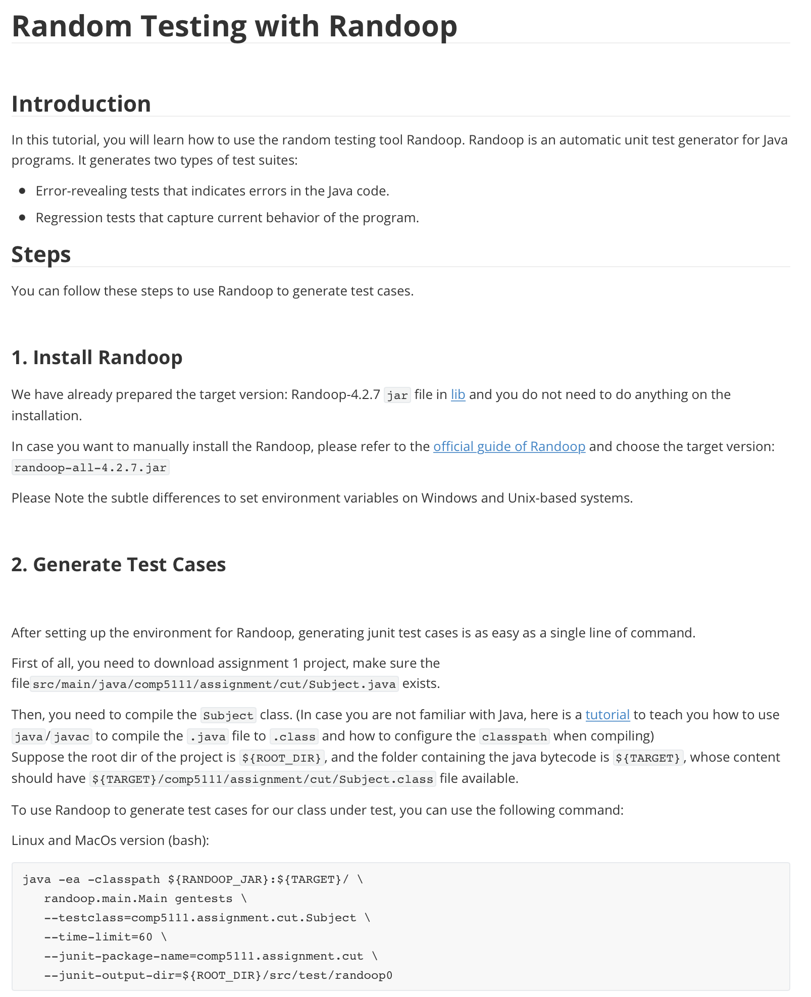
Task 1.1: Randoop
Objective:
Use Randoop to generate five test suites for the program under test
Step:
Install Randoop
Generate test case
Run the unit test cases
Tutorials: our github repository

Slide 7
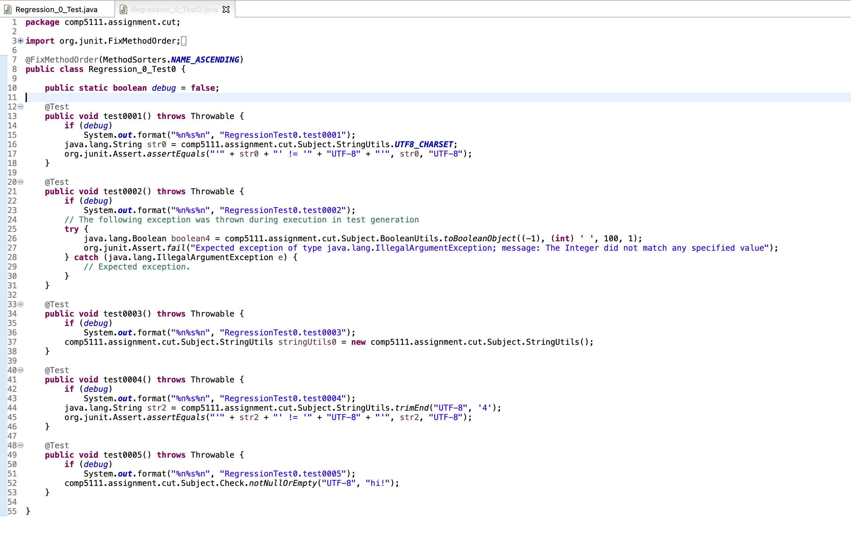
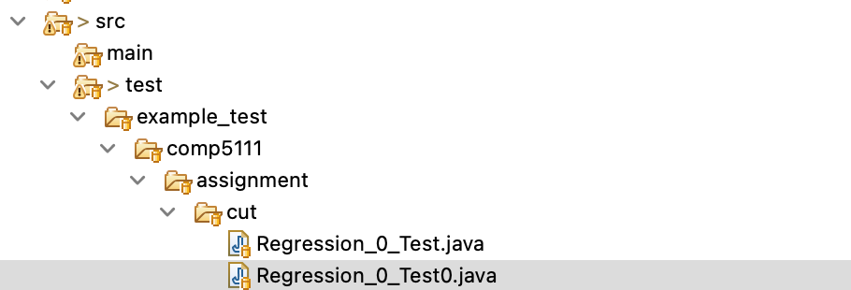
Task 1.1: Randoop
Note: Each test suite must achieve at least 60% statement coverage!
Output: test cases
Two types of test suites generated by randoop:
Error-revealing tests that indicates error in the Java code
Regression tests that capture current behavior of the program

Slide 8
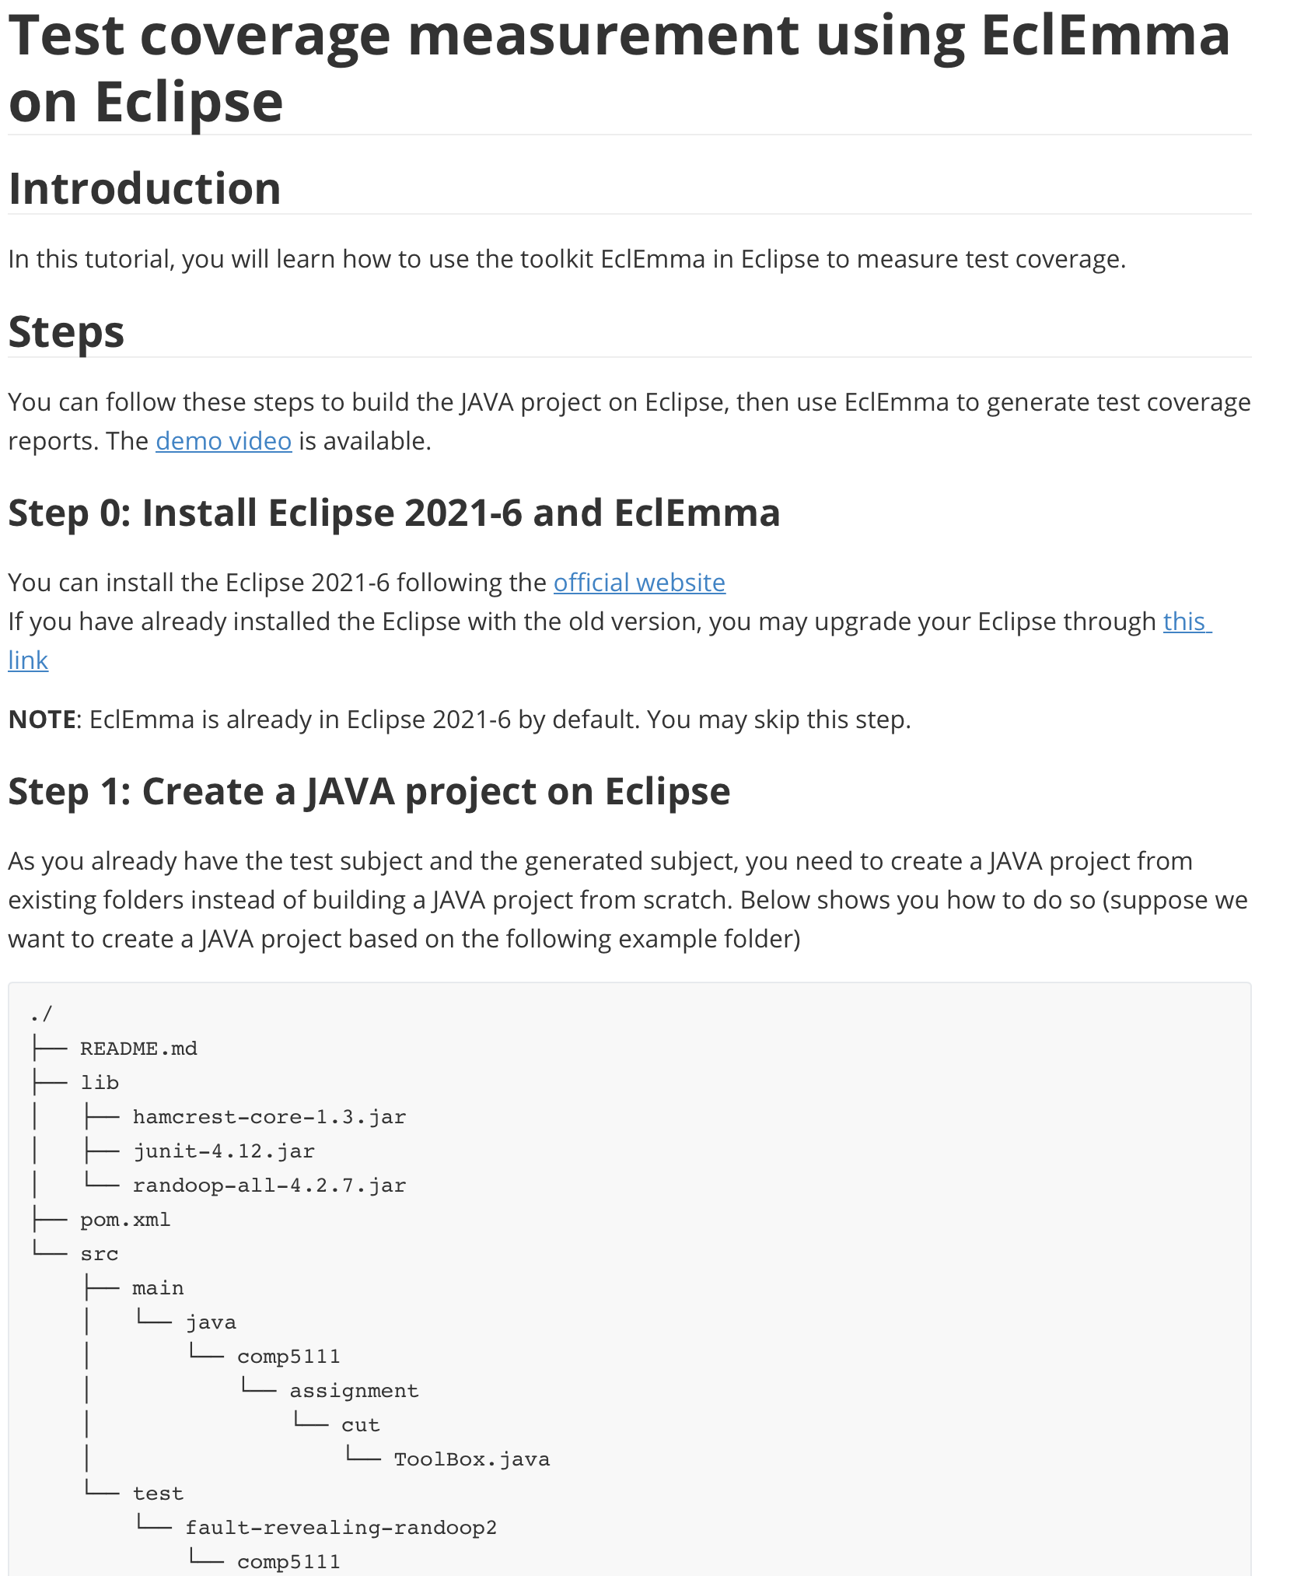
Task 1.2: Measuring Test Coverage using Eclipse / EclEmma
Objective:
Use Eclemma to measure the coverage of generated test cases
Step:
Step 0: Install EclEmma/Eclipse
Step 1: Create the Java project
Step 2: Run the unit test cases
Step 3: Read the report
Tutorials: our github repository

Slide 9
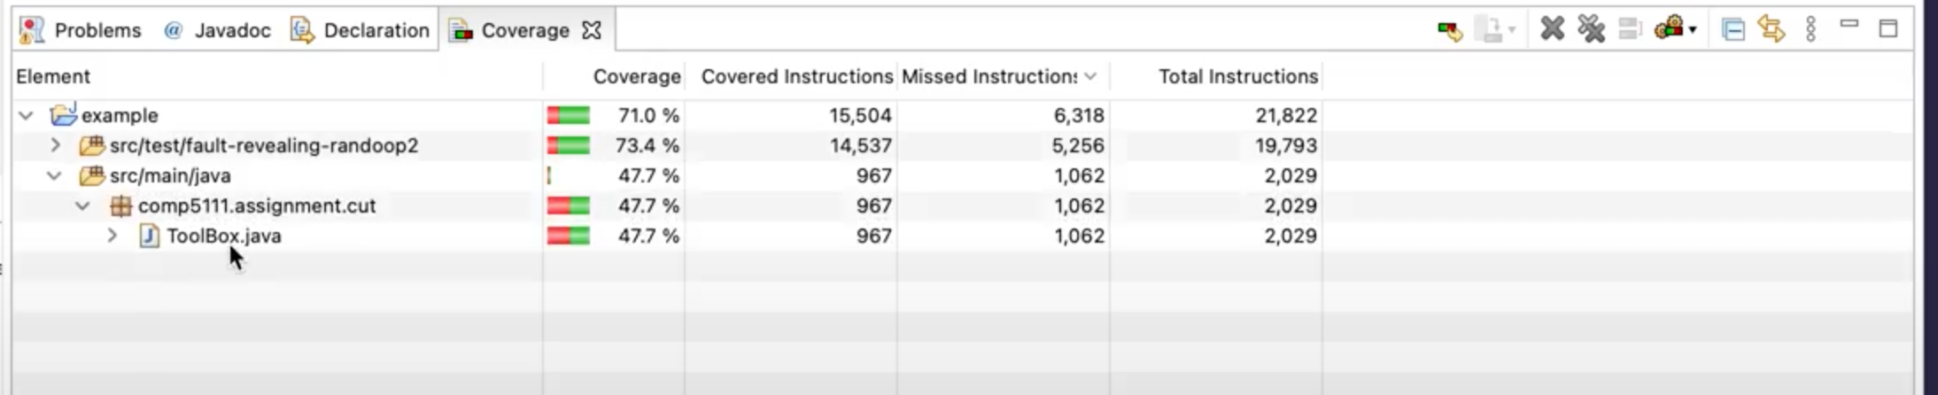
Demo video for using Eclipse / EclEmma
https://drive.google.com/file/d/1DZAGe0WpumKhFayyKqE2bDjnS3t9D42i/view?usp=sharing
You may also refer to professor’s introduction video for JUnit:
https://hkust.zoom.us/rec/play/Iz1qMhA1zNKiqKJzTjm_xMhBZ1xT958mtLtp1PQzmnLxggj6VZW3PJ2Etvbk7pZfbUUVwiu8xs6N0cTF.VxDlIV3ddDLVmG6f

Slide 10
Task 2, 3 & Bonus (40% + 30% + 15%): Measuring Test Coverage with Soot
Objective: Develop a coverage tool with Soot!
It sounds hard, but actually it is easy!
Once you understand Soot.

Slide 11
Frist of all…
You need to understand what is coverage
Method Coverage (Call Coverage)
Instruction Coverage (Statement Coverage)
Branch Coverage
Line Coverage
Test coverage will be taught later in class (in week 3)

Slide 12
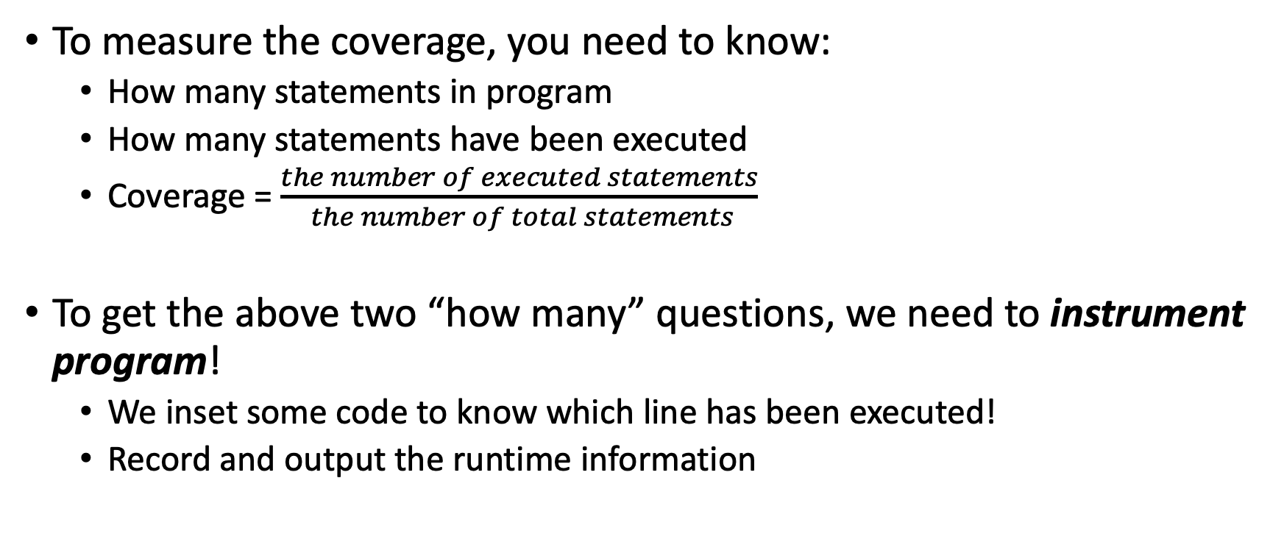
Statement Coverage
To measure the coverage, you need to know:
How many statements in program
How many statements have been executed
Coverage = $\frac{the number of executed statements}{ the number of total statements}$
To get the above two “how many” questions, we need to instrument program!
We inset some code to know which line has been executed!
Record and output the runtime information

Slide 13
Program Instrumentation
One or more statements inserted into the program to monitor some aspect of the program
Must not affect the program behaviour
May affect program runtime
Help us in:
Code tracing
Debugging
Profiling
Data logging

Slide 14
Soot
We use Soot to instrument program
Instead of manually inserting code
A Java Optimization Framework
Static Analysis (control flow analysis, call graph, point-to analysis, … )
Instrumentation
Optimization

Slide 15
Soot
Input
Java Source Code
Java Bytecode (Recommended), what we will analyze
Intermediate Representation
Jimple (what we will use)
Baf
Shimple
Grimp
Output
Optimized Java Bytecode

Slide 16
Workflow of Soot
Optimization on Jimple code
Java Bytecode
Jimple Code
Java Bytecode
(optimized)

Slide 17
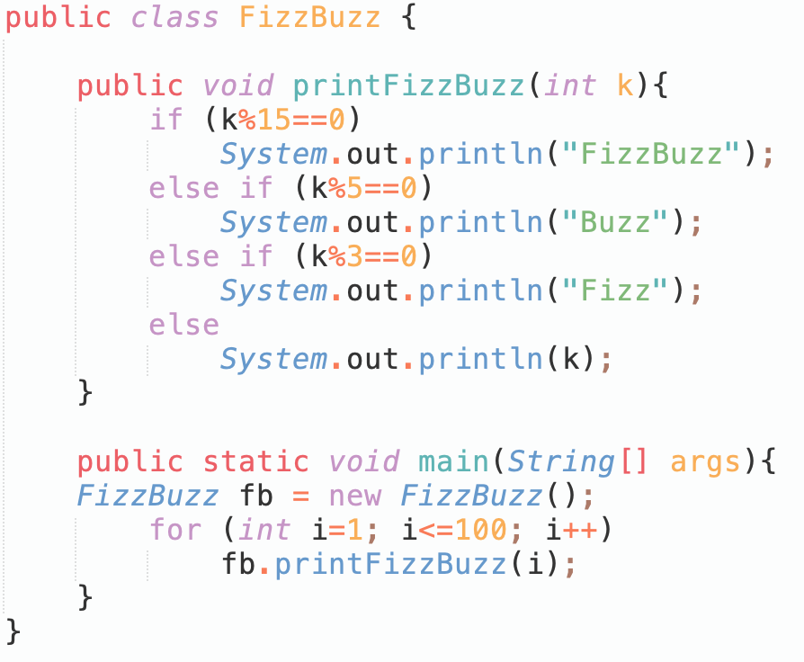
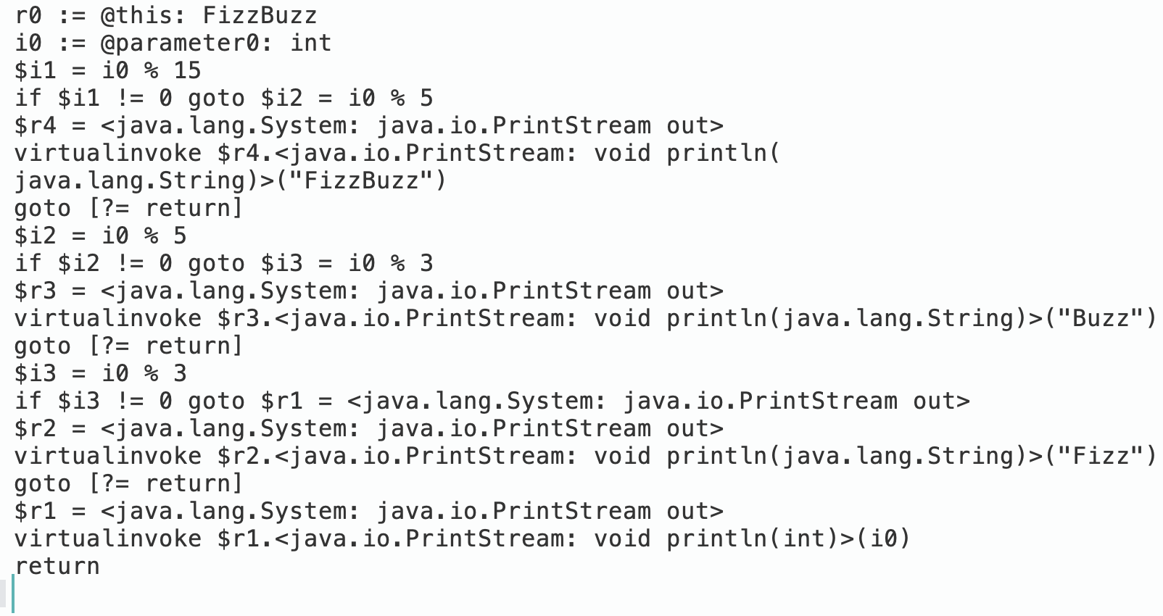
The intermediate representation: Jimple
Jimple is the default IR in soot which is between Java source and Java bytecode.

Slide 18
Phase
Each phase is corresponding to a collection of transformers.
The optimization could have multiple phases.
We need to add our ‘instrument’ phase into the optimization
Customize our own phase in Soot
Program instrumentation will be done in our own phase
Our phase will leverage the Jimple code (thus, our phase should be after the Jimple code is created)
Our phase will insert the instruction using Jimple code

Slide 19

Example: Count Method Invocation
Objective: Count how many times static/instance methods of a class under test are invoked in a test suites.
First of all, we need to know insert what code to where
Insert a statement to increase the counter in each method.
Second, create our own phase
Example is available in our course website:

Slide 20
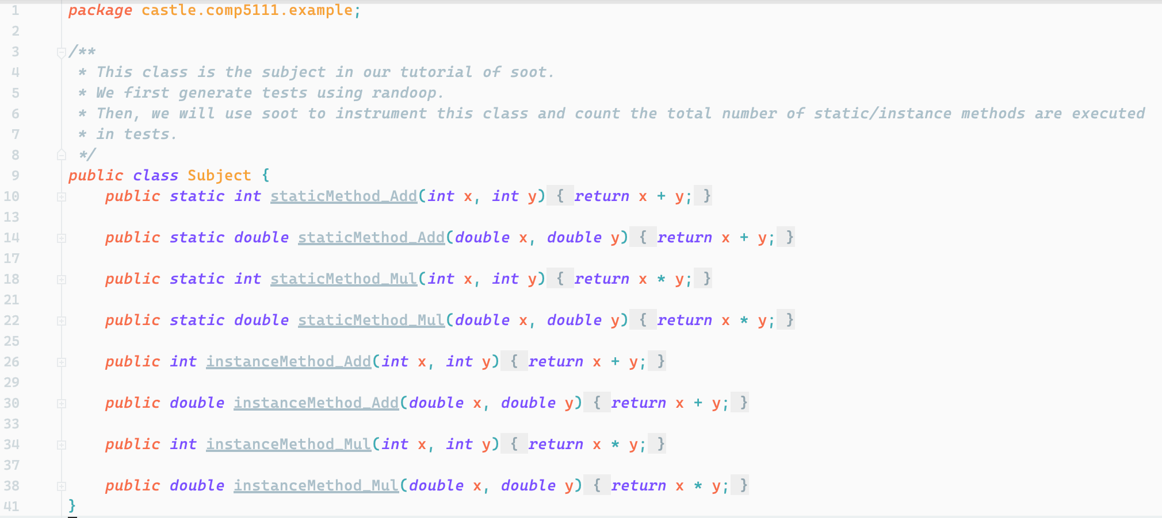
Class Under Test (CUT)

Slide 21
Customize Our Own Phase
Add our own phase into Soot
Add after Jimple code is created
/* add a phase to transformer pack by call Pack.add */
Pack jtp = PackManager.v().getPack("jtp");
jtp.add(new Transform("jtp.instrumenter",
new InvokeStaticInstrumenter()));
The implementation of our own phase Instrumenter should
Extend an abstract class BodyTransformer
public class InvokeStaticInstrumenter extends BodyTransformer{…}
Implement the method internalTransform
@override
protected void internalTransform(Body body, String phase, Map options) {…}
Our customized phase will be executed by:
String classUnderTest = "castle.comp5111.example.Subject";
// pass arguments to soot
soot.Main.main(new String[]{classUnderTest});

Slide 22
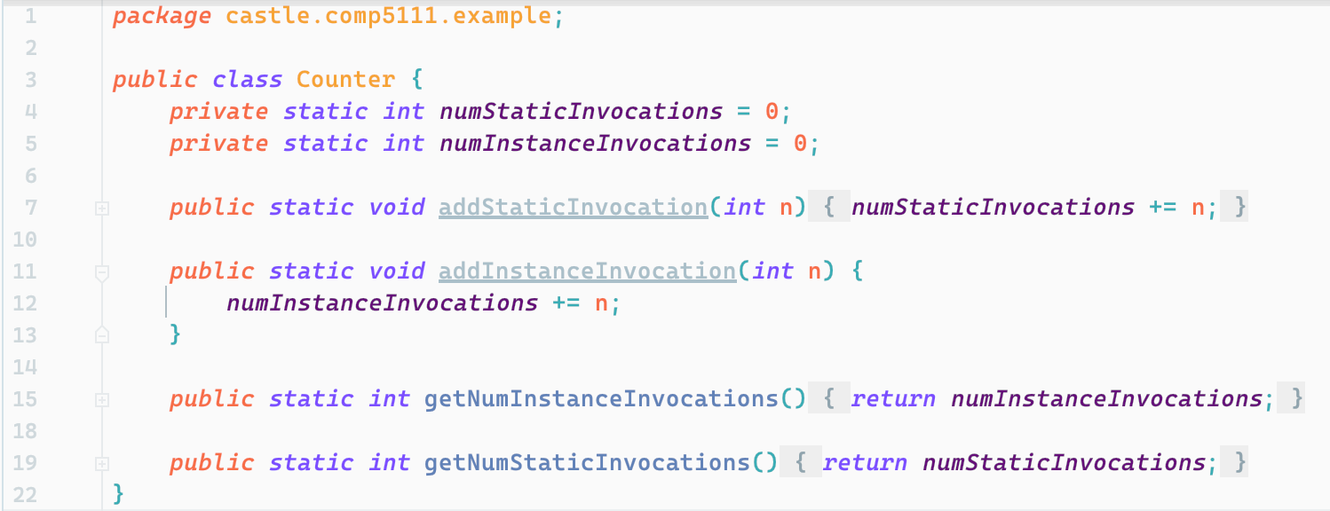
Create Helper Class: counter
Counter
The code to be inserted in class under test
The code to be called after the execution of tests to get counting results.

Slide 23
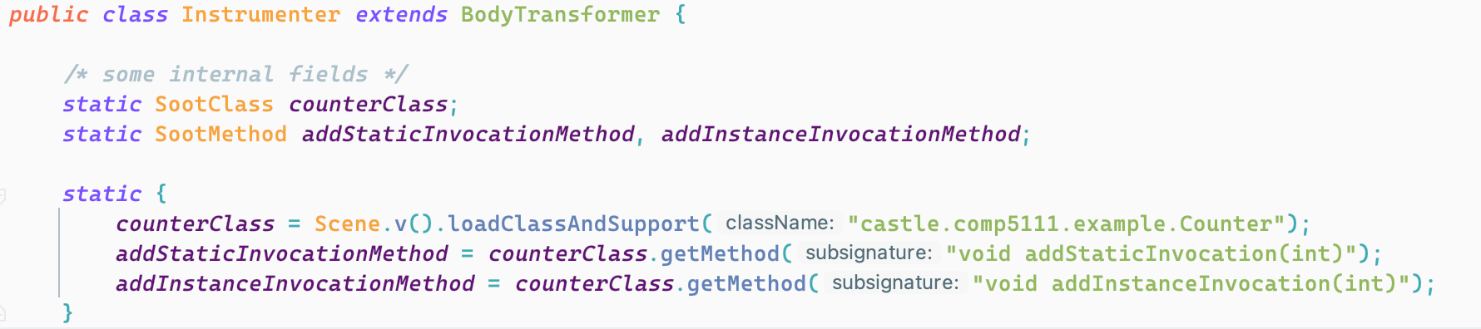
Implementation of Our Own Phase
Initialize the Helper Class
Initialize the profiling method
Initialize the report method
Scene: a singleton class contains everything related to the code under analysis

Slide 24
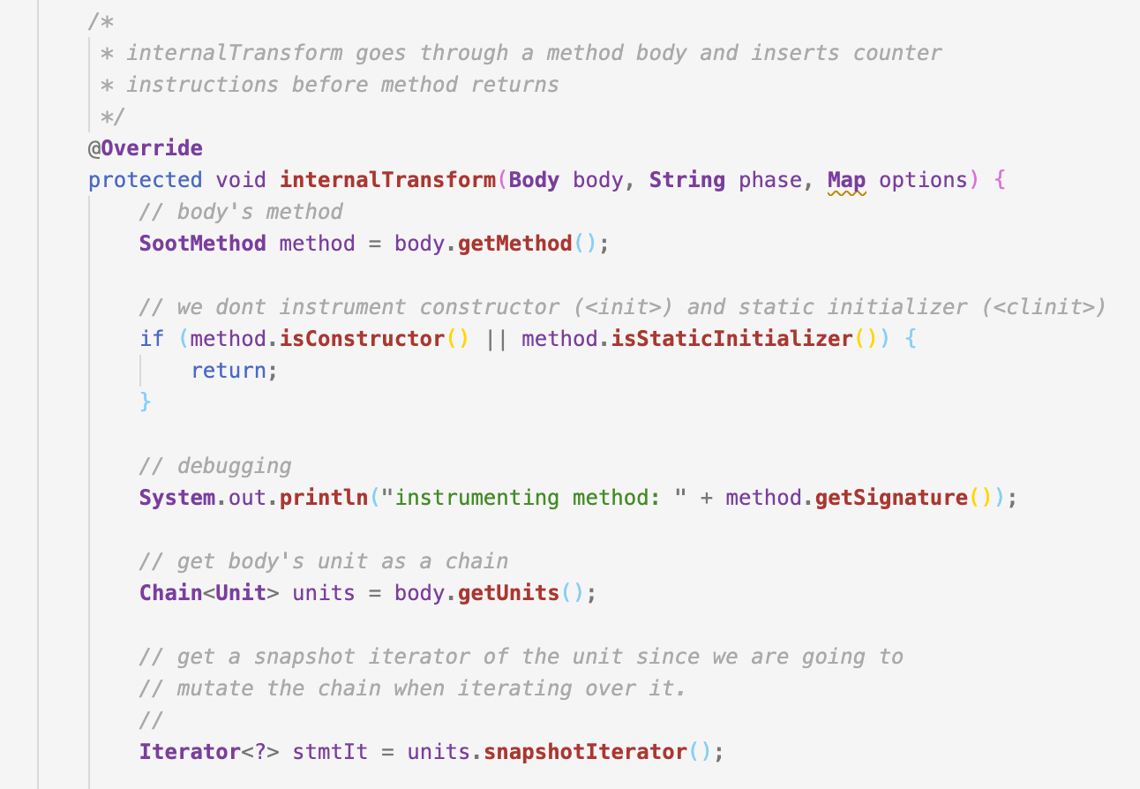
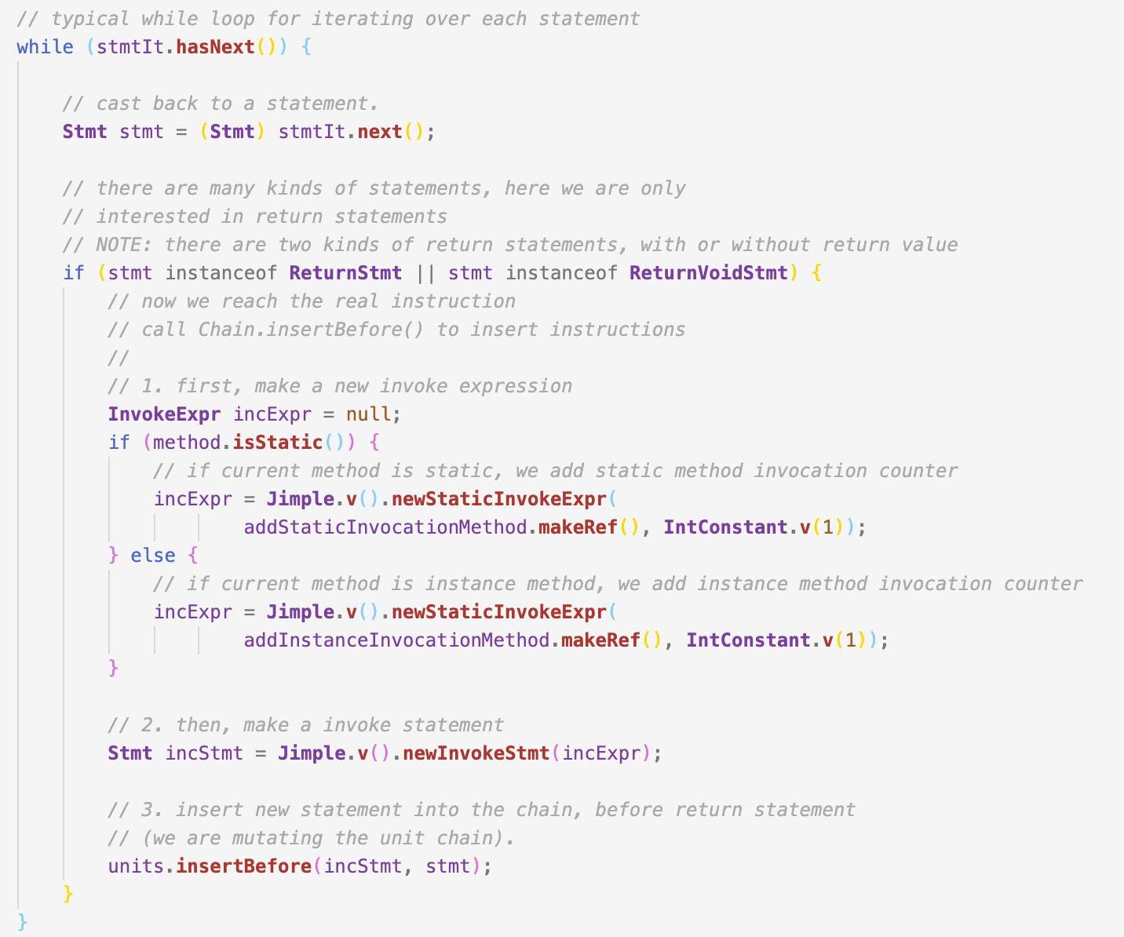
Implementation of Our Own Phase
Insert the statement calling Counter methods before each return statement.
Note: internalTransform will be executed when each method in the CUT is invoked.

Slide 25
How to Run: Scripts
Generate tests for CUT using randoop
scripts/gen-tests.sh for Linux/MacOS
scripts/gen-tests.cmd for Windows
Instrument and run tests
scripts/instrument-run-test.sh for Linux/MacOS
scripts/instrument-run-test.cmd for Linux/MacOS

Slide 26
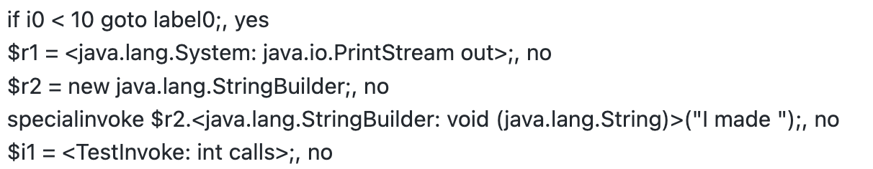
Common Problems
The total number of statements recorded by Soot is different from EclEmma.
This is normal because EclEmma and Soot is using different intermediate representation (IR). Therefore, the total number of statements is different. You may only refer to the statement (branch) coverage for reference and they are close.
How to present the coverage of each statement/branch/line?
You can choose any format you like as long as the result is clear. Here is one example:

Slide 27
Tips:
Start from the example
Understand the code and the logic
You assignment is very similar with the example
Go through the soot document
Know the API!
https://github.com/soot-oss/soot/wiki
If you have problem:
Read FAQ on our website first
Contact with me (By email or open an issue)

Slide 28
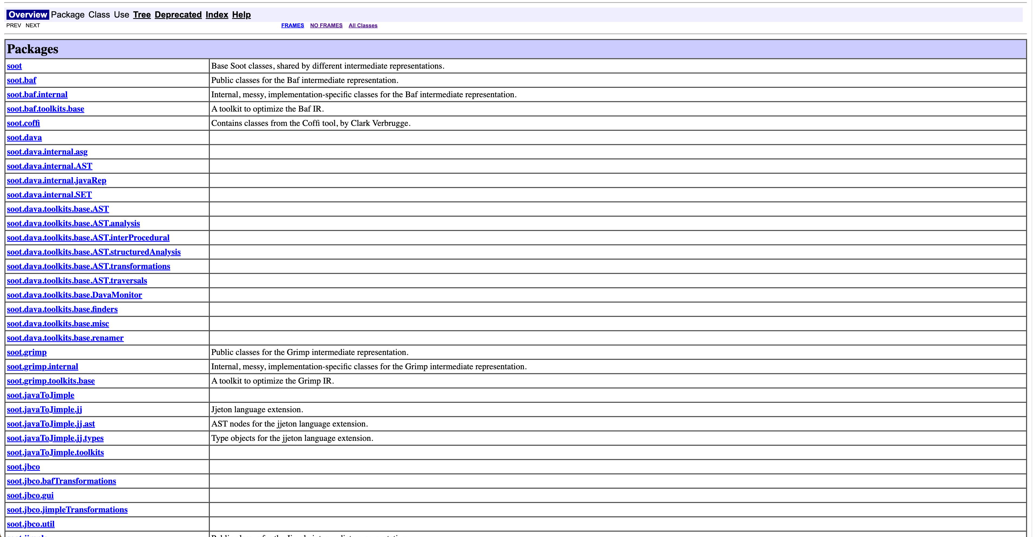
Useful Resources
https://www.sable.mcgill.ca/soot/doc/overview-summary.html

Slide 29

Useful Resources
https://noidsirius.medium.com/a-beginners-guide-to-static-program-analysis-using-soot-5aee14a878d

Slide 30
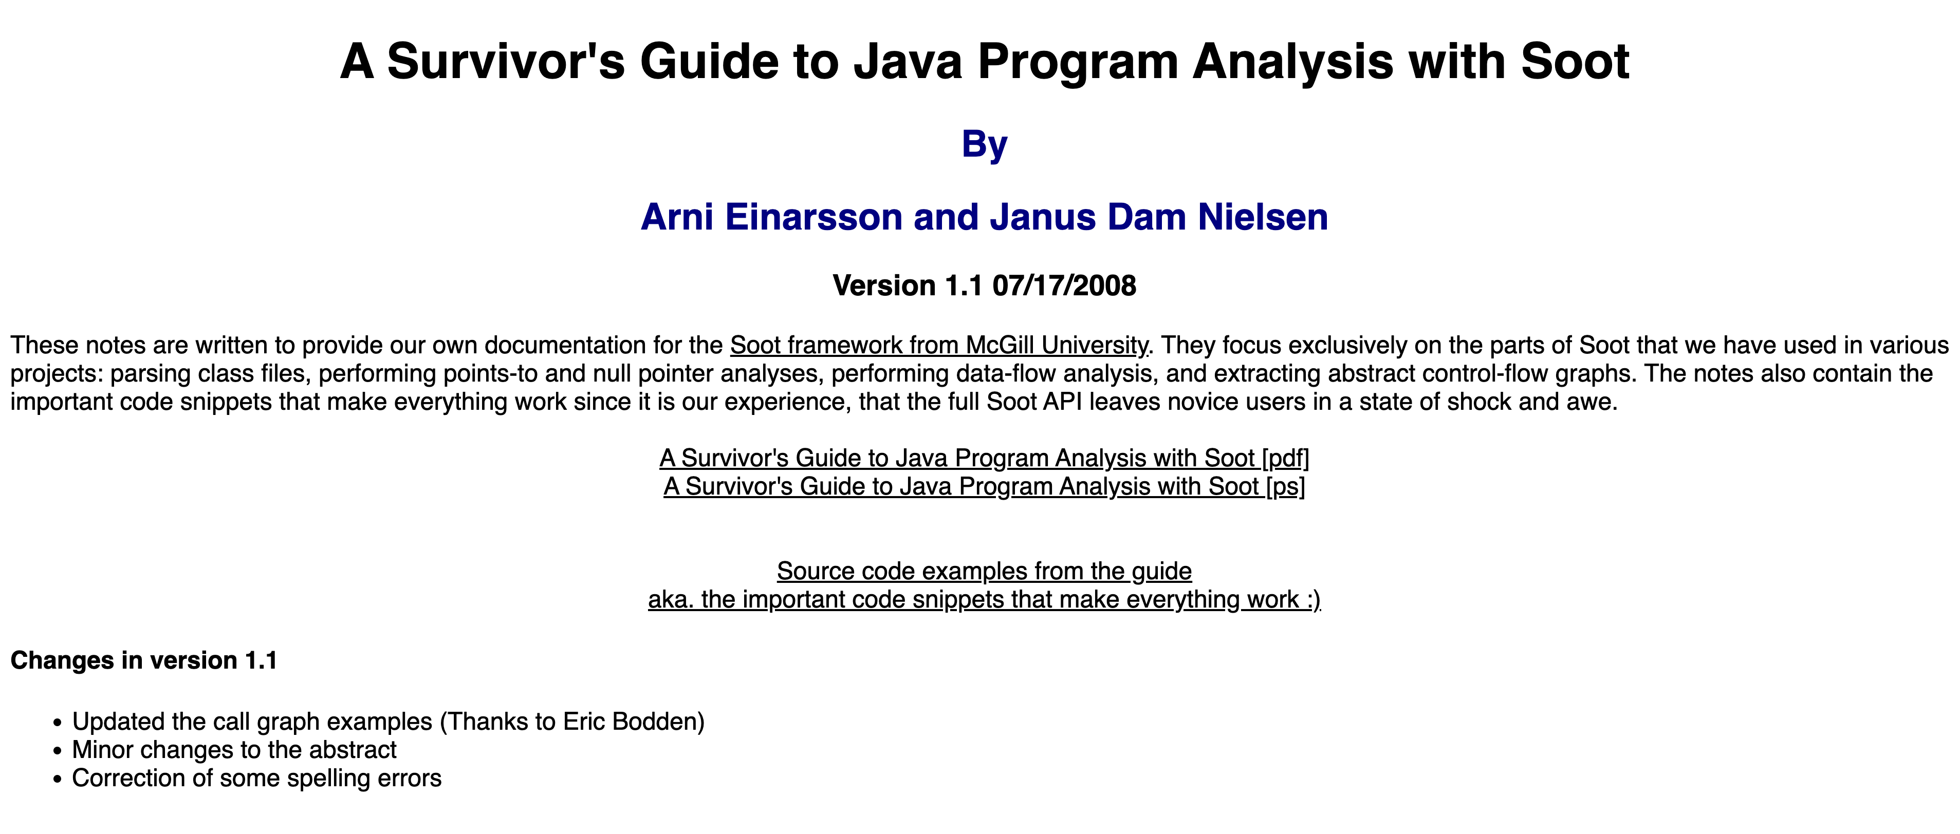
Useful Resources
https://www.brics.dk/SootGuide/

Slide 31
Useful Resources
https://www.brics.dk/SootGuide/

Slide 32
Submission:
Submission requirement
Please check the assignment website
Deadline: 14th March 23:59
Do it as soon as possible.

